Slide 1
Supporting the First Phase of Analysis - Student Data Quality

Slide 2
Approach & Context
The brief: data quality assessment ahead of a system transformation.
Approach:
Guided learning exercise - no prior HE or student data experience.
Used AI tooling to build a synthetic dataset and to help structure the analysis.
Goal: demonstrate my framework and how I'd communicate findings.
Analysis performed using DuckDB and SQL (CSVs -> DuckDB).
Data quality issues have direct regulatory consequences – student records feed into HESA returns (mandatory), these affect funding and compliance with the Office for Students.
Notes:
I used AI tooling in 3 ways:
To generate the synthetic dataset, so I had realistic student records with seeded data issues.
I used it as a sounding board to help me think through the structure of the analysis.
I also used it to get up to speed on the HE context — understanding how HESA returns work, what the regulatory stakes are, the kind of systems a university typically runs. Background knowledge I didn't have going in.
My data was in 3 CSVs, one per system. I loaded each into DUCKDB as a table and ran the analysis from there.
Through my research I learned that – read from slide.

Slide 3
1. Information Gathering & Stakeholder Engagement
Before any analysis begins, the right information needs to be in place. This covers who to engage and what to gather.
Who | What to gather
IT / System Owners | System architecture, data flows, access arrangements. Key question: do systems share a common student identifier?
Registrar / Academic Admin | What each field means in practice, known issues, existing workarounds.
BI / Reporting Team | Existing reports, where discrepancies have already been flagged, what decisions the data drives.
Documentation | Data dictionaries - defines what each field means and what values are valid ERDs / data models - shows how tables and systems relate to each other Process maps - how data gets created and updated, and by whom Previous audit findings - any prior data quality work, so you're not starting from scratch
Senior Stakeholders | Transformation goals, definition of "good data", regulatory deadlines (e.g. HESA return date).
With this foundation in place, the data landscape can be mapped and profiling can begin.
Notes:
So the first group of people we have are IT/System owner, they will be able to provide information about system architecture, data flows and arrange access to the data. They will also be able to answer Qs like – read from slide – which comes up later in the task.
The next group are the reg/AA , these are people using the systems day in and day out, and therefore have a good understanding of known issues and workarounds. They will also we able to explain what the fields mean In practise.
Next, we have the BI/R team, they will be able to highlight where discrepancies in the data have already been flagged, and importantly, what decisions the data drives.
Moving onto documentation – These represent a written record of what the data means, how it's structured, how it flows, and what's already known to be wrong.
Entity Relationship Diagram.
Finally, senior stakeholders tell you why the transformation is happening, and what success looks like from a data perspective.

Slide 4
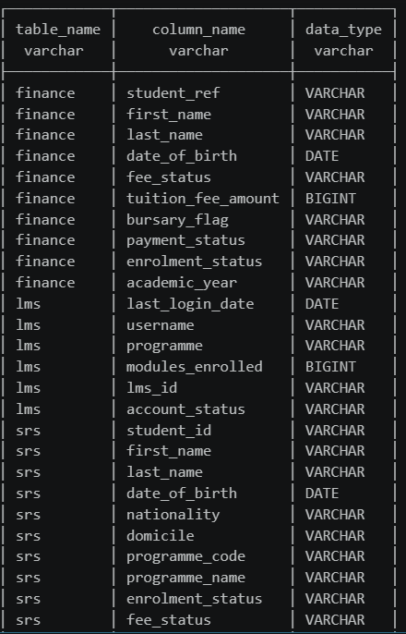
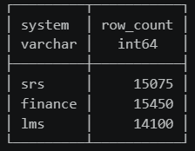
2. Understanding the Data Landscape
Three systems hold student data across the university, each with different structures, field names, and record counts.
System row counts - immediate discrepancy across all three systems
Field inventory - different identifier fields, no shared key, varying levels of data richness
Differing row counts and no common identifier suggested data quality issues before any profiling had begun.
Notes:
Whilst examining the structure of the data landscape, I discovered that – read slide (intro line)
From the left hand screenshot we can see that each system has a different row count, meaning that they disagree on how many students there are. They should be covering the same population but aren’t.
The field inventory on the right shows there is no common identifier across all 3 systems. Meaning you cannot easily join the tables to find out why the counts differ.
So to summarise – read last point.

Slide 5
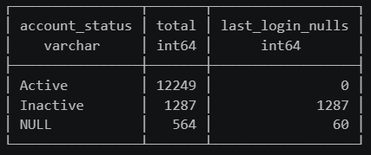
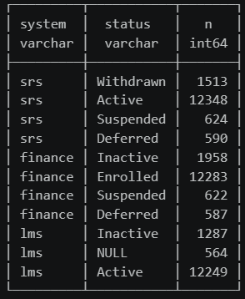
3a. Identifying & Categorising Data Quality Issues
Data Understanding — Quality
Null Checks - 1,347 null last login dates in the LMS system. 1287 mapped to Inactive accounts - every Inactive student had a null login date, and every Active student had a valid one, suggesting this may be by design rather than a data quality issue.
564 records had null account_status - yet 504 of these had login history, suggesting students who accessed the system were never assigned a status.
Value Distributions – The systems use different field names and labels - SRS uses Active/Withdrawn, Finance uses Enrolled/Inactive. LMS uses account_status rather than enrolment_status, which is binary, and appears to be tracking a separate concept entirely. Equivalence could not be confirmed without stakeholder input.
Duplicate Checks - 76 students in SRS share a name and date of birth with another record - root cause unknown; could be migration artefacts or data entry errors.
Notes:
Nulls
The first thing I did was run null checks (If asked explain SQL, count(*) - count(col)). I found – read slide.
The more interesting finding from the null checks was the 564 nulls in account status. We can see from this query that active students have a valid last_login, and inactive students have a null last_login. But 504 of the account_status nulls also have a valid last_login, meaning students had used the system, but not been assigned a status. – Should students who have logged in have an account status assigned? Ask registrar or system owner.
Value Distributions
The field inventory showed that all 3 systems track student status, we need to explore if these are equivalent by looking at the value distributions. I found that – read slide
Dupes
The last thing I checked during this phase was duplicates – I found that – read slide
If asked – the two duplicate checks were:
Duplicate IDs - same ID assigned to different people, an ID collision.
Same person, different IDs — one person appearing multiple times under different identifiers. That's what your 76 SRS records are — same name and DOB, suggesting the same individual entered more than once.

Slide 6
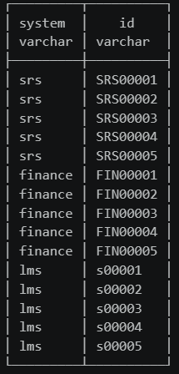
Cross-System Analysis
3b. Identifying & Categorising Data Quality Issues
Sampling ID formats across systems revealed each used a different identifier and prefix - SRS00001, FIN00001, s00001.
Linkage was achieved by stripping prefixes and matching on the numeric component.
To validate the join, I checked that shared fields - first name, last name, and date of birth - agreed across all 15,000 matched records. All three matched 100%, confirming the ID linkage is reliable.
Population Gaps:
SRS has 15,075 rows. Finance has 15,450 rows.
Cross-system matching found 15,000 IDs present in both systems.
Therefore: 450 Finance records have no SRS match, and 75 SRS records have no Finance match.
Notes:
With the within-system analysis done, the next step was to look across systems to understand whether they could be reliably linked for further analysis.
Read slide.
But matching on numeric ID alone only confirms the numbers align - it doesn't prove the records belong to the same person
I found population gaps in SRS and Finance tables. We know that SRS has 15075 rows, and Finance has 15450 rows. Yet the join only found 15k matching IDs. Therefore - read slide.

Slide 7
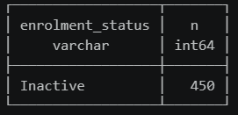
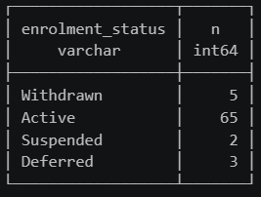
4. Root Cause Investigation
After examining the 450 Finance records not present in SRS, all 450 had an enrolment status of Inactive. These may be:
Records that were deactivated in SRS but never removed from Finance.
Records added to Finance directly that never made it into SRS.
After examining the 75 SRS records not present in Finance, the majority (65) had an enrolment status of Active – These may be current students who should have a finance record but don’t, making this the higher priority finding.
Notes:
Moving onto the root cause investigation, I choose this example because there were 2 population gaps.
Read from slide
These are unlikely to be causing an active problem for current students, which is why it has been flagged as lower priority in the issues register.
If asked about the query – I took the Finance table and LEFT joined SRS on the stripped IDs and filtered to select the records in Finance but not in SRS. All 450 had enrolment = inactive.
The second population gap was investigated in the same manner – read from screen
Are these students actually enrolled and attending classes without any payment history?

Slide 8
5. Outputs & Recommendations
Output | Description
Issue Register | Structured log of all DQ findings — categorised, scaled, and prioritised.
Initial findings summary | Short brief for senior stakeholders on the scale and nature of the issues.
Recommended next steps | Escalate the high priority findings and flag the items that need stakeholder confirmation before any action is taken.
Notes:
Moving onto outputs and recommendations – this table show what I would expect to be producing.
An issue register, which can be found on the next slide. – read description
The proposed next steps from my side would be to – read slide.

Slide 9
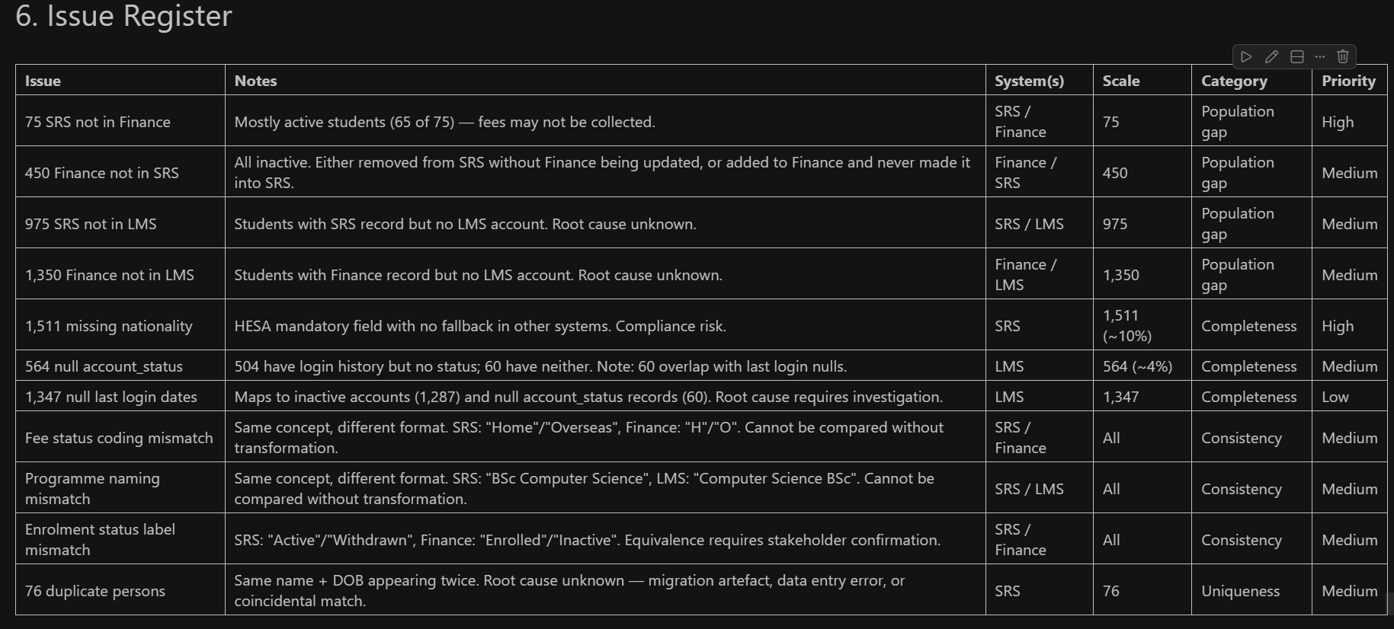
Issue Register
Notes:
The issue register captures all 11 findings, categorised by type, scaled by volume, and prioritised.

